Slide 1
Boe-bot Down!
By: Conner Craighead
Benjamin Hargrove
Taylor Mathews

Slide 2
Overview
Goal: To challenge the individual’s understanding of circuits, logic gates, and binary numbers.
The player is required to toggle 8 inputs between high and low in order to complete a puzzle consisting of logic gates. After completing the four puzzles, the player must decipher a binary number displayed by 3 LEDs and connect a wire into the correct analog input pin on an Arduino Uno. Once the wire is correctly connected, the Boe-bot begins to drive in circles, and the player has finished the challenge.

Slide 3
Bill of Materials
Raspberry Pi (with display)
Pi Cobbler
Breadboard
Arduino Uno
Parallax Continuous Rotation DC Servo x2
LED x3
Wire x17
220Ω Resistor x5

Slide 4
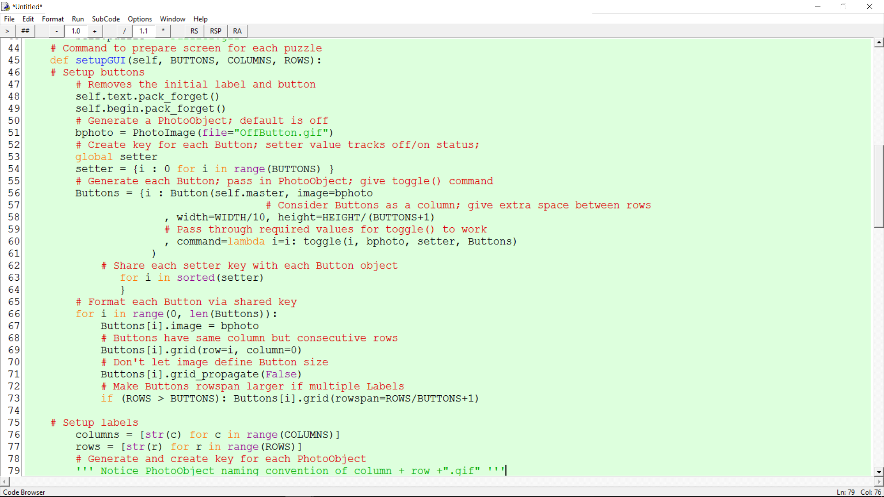
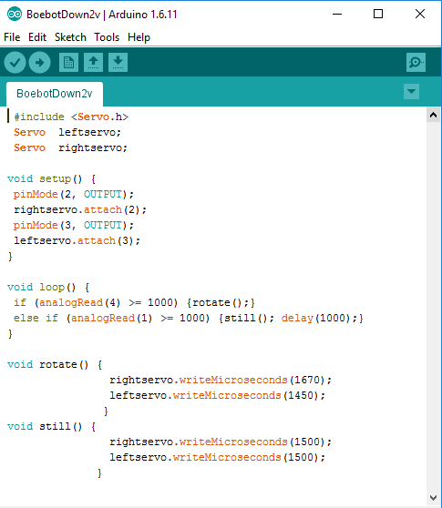
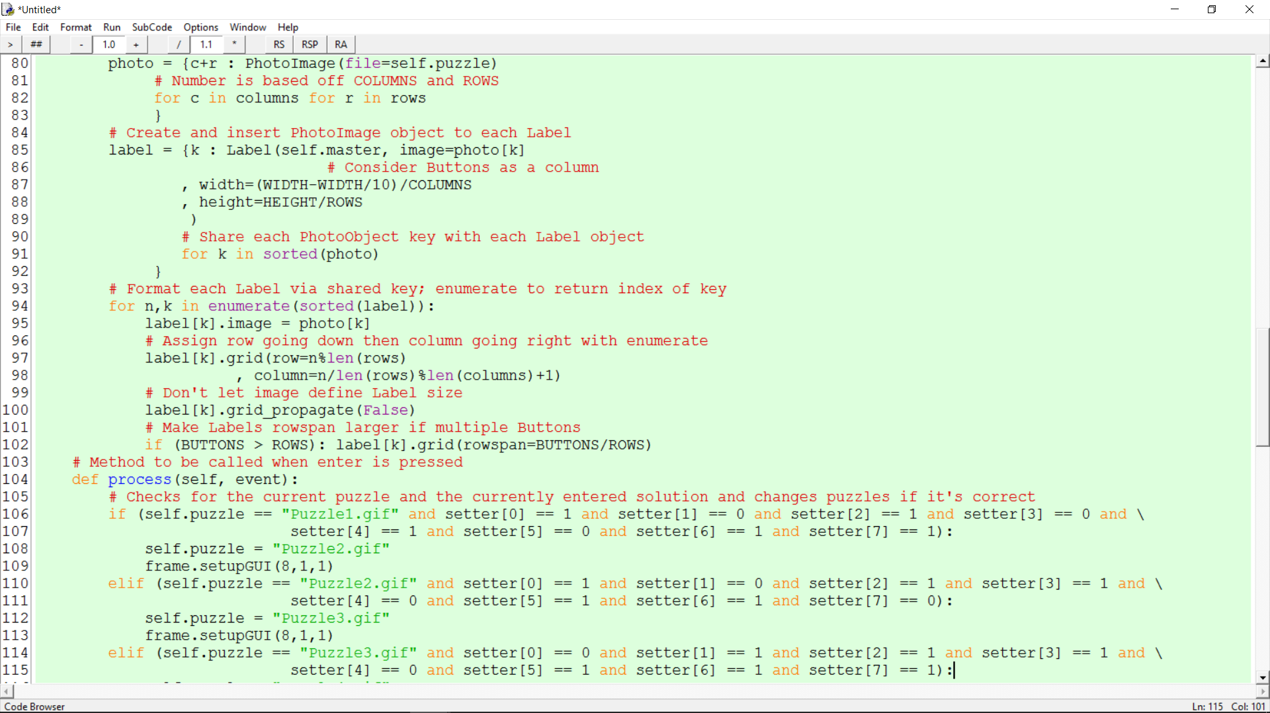
https://github.com/TeejM/improved-spoon

Slide 5
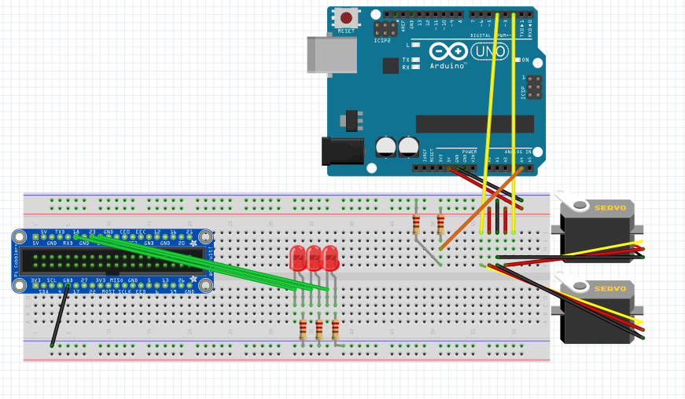

Slide 6
Rank | Team | Time | Points
1 | Draco | 3:30 | 20,000
2 | Crater | 4:00 | 16,600
3 | Phoenix | 6:00 | 11,100
4 | Canis Major | 6:50 | 10,300
5 | Chameleon | 7:15 | 9,300
6 | Canes Venatici | 10:30 | 6,500
7 | Taurus | 12:00 | 5,500
8 | Vulpecula | 12:00 | 5,500

Slide 7
Future Plans
Implement more hardware aspects (LED and resistor hot/cold game)
Correct serial communication using Python on the Raspberry Pi
More dynamic puzzles without increasing difficulty
Clarity, including sounds for (in)correct solutions

Slide 8
Lessons Learned
Tkinter is not intuitive, at least at the start
Waiting until the last week isn’t always the best approach
Getting something working on one device does not translate to it working on another
Beta test your puzzles/challenge

